Slide 1


Stroke: An Analysis of Predictive Factors for Intervention
By Elise Dixon, Kyle Moran, and William Elijah-Clark

Slide 2
Motivation
Stroke is a leading cause of death and disability
Few preventative practices especially for younger patients
Most patients <65 do not recognize common stroke symptoms (https://www.ahajournals.org/doi/full/10.1161/01.str.28.10.1871)
Length of time from stroke to treatment critical to outcome
Nearly half do not know they are having a stroke, delaying treatment (https://www.ahajournals.org/doi/full/10.1161/01.str.28.10.1871)
Identify major risk factors for easy implementation of preventative practice in diagnosis of individual risk

Slide 3
Data Description
The data was downloaded onto excel and imported into SAS as CSV kaggle.com/fedesoriano/stroke-prediction-dataset
362 predictions
Binary response: (Occurrence of) Stroke
Predictors: Age, Glucose, BMI, Smoker (categorical)
PROC IMPORT CODE:
FILENAME CSV "/home/u52292162/Assignments3064/Stroke.csv" TERMSTR=CRLF;
PROC IMPORT DATAFILE=CSV
OUT=StrokeData
DBMS=CSV
REPLACE;
RUN;
PROC PRINT DATA=StrokeData; RUN;
FILENAME CSV;

Slide 4
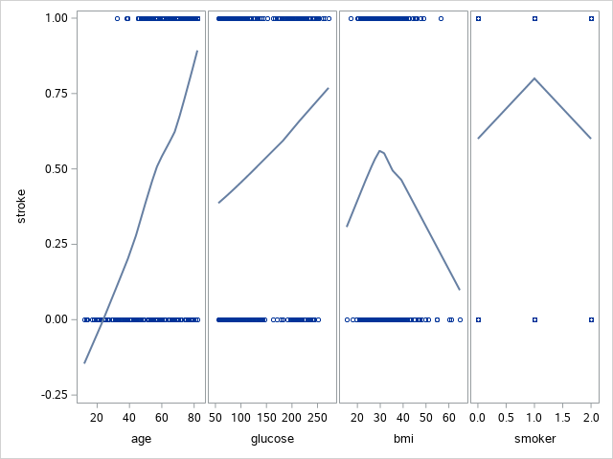
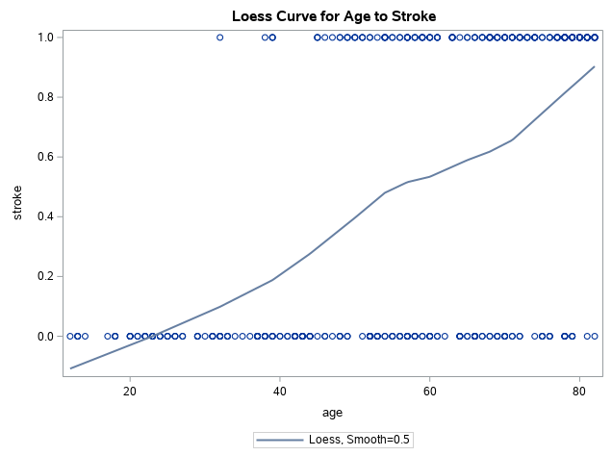
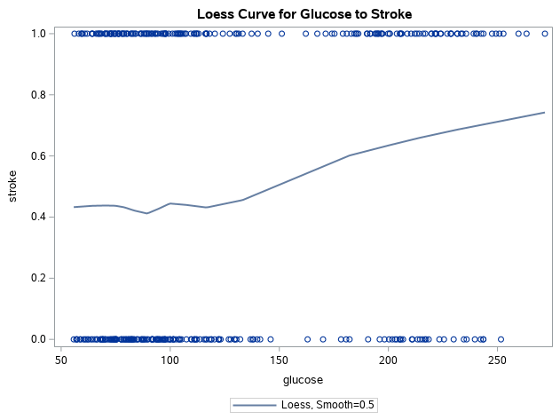
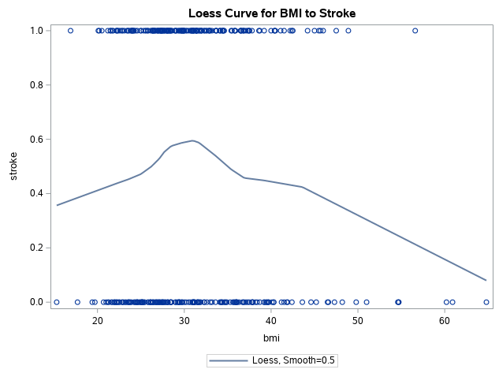
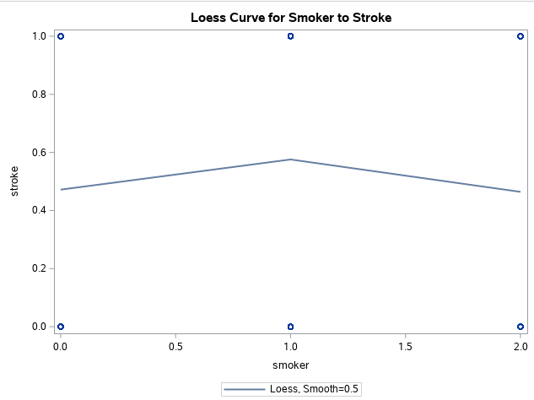
Data Exploration
362 of over 3000 observations
3 categories removed (gender, urban/rural, married)
Observations with unknown BMI removed
Age has clearest logistic relationship
Glucose potentially has logistic relationship
BMI, smoker do not seem to have logistic relationship

Slide 5
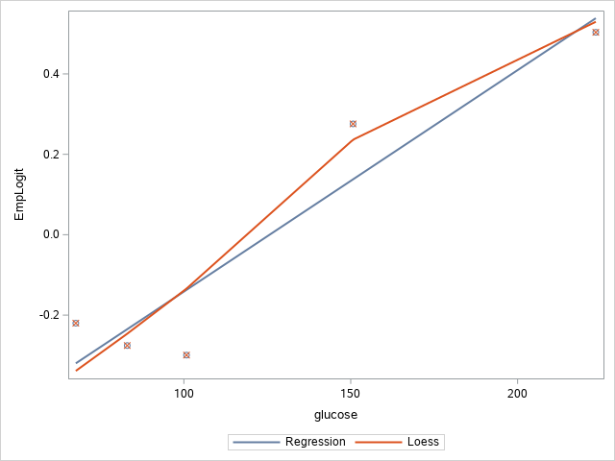
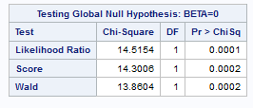
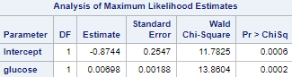
Model Fitting and Analysis single-variable #1
Glucose level is statistically significant
Likelihood ratio at 14.5154
Likelihood ratio p-value <.0001
Empirical logit plot is a good fit (some deviation)
Glucose level is an effective predictor of stroke
Our model for glucose to stroke is
Y=-00698+0.00698(glucose)+ ε

Slide 6
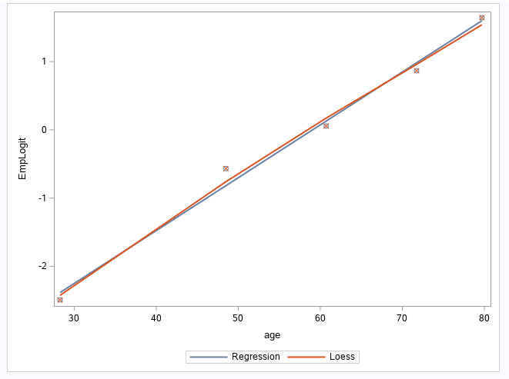
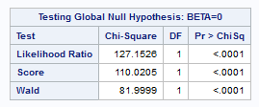
Model Fitting and Analysis single variable #2
Our alternate single-variable model compares age to the likelihood of a stroke.
With our SAS output, we can determine the single variable model:
Y= -4.7865 + 0.0810(age)+ε
We can also determine the point estimate of glucose as 1.084 per unit
We can verify goodness-of fit with Pearson and Homer-Lemeshow tests
Finally, we can also verify goodness-of-fit with our Likelihood Ratio at 127.1526

Slide 7
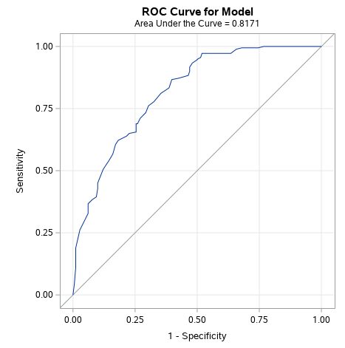
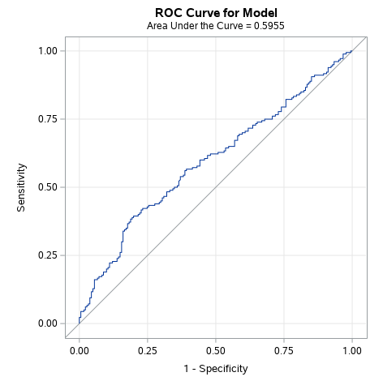
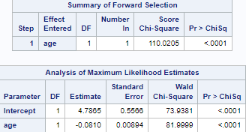
Model Fitting and Analysis single variable
Best models seems to be Age and Glucose as predictors; model suggests high predictive significance with a likelihood ratio <.001
Predicted Values Age ROC Curve Glucose ROC Curve

Slide 8
Model Fitting and Analysis Multi-variable analysis
VIF is <1.2 for all variables (glucose highest at 1.16)
Age and smoker highly correlated because smoking has sharply decreased in popularity over time
Selection methods inconclusive because of the high predictability of age
Objective is diagnosing risk, so should age be removed?
Further analysis indicates age, glucose, and smoker are correlated, but BMI seems significant and non-multicollinear

Slide 9
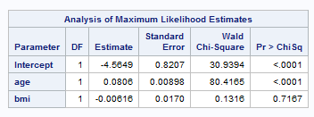
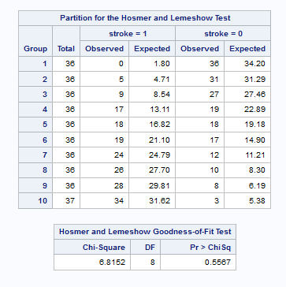
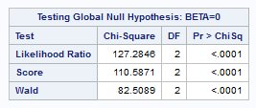
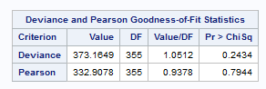
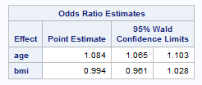
Model Fitting and Analysis (Multi-Variable Model #1)
Age is highly significant
Age p-value is <0.0001
BMI p-value is 0.7167
BMI might not show improvement due to how significant age is by itself
Likelihood ratio is 127.2846, indicating fit is better than for age alone.
Likelihood ratio p-value is <0.0001
The Pearson Test p-value is 0.7944
The Homer-Lemeshow Test p-value is 0.5567
Both tests indicate the model fits well
Model is Y= -4.5649 + 0.0806(age)-0.00616(BMI)+ε

Slide 10
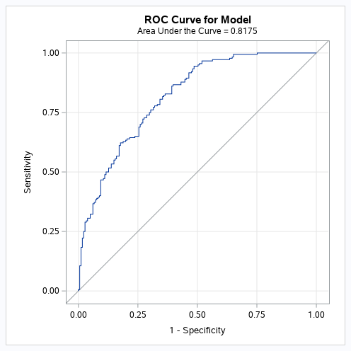
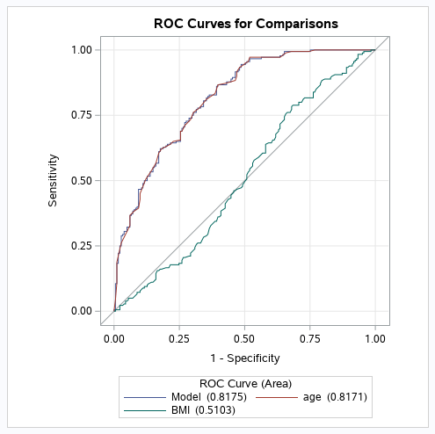
Model Fitting and Analysis (Multi-Variable Model #1 ROC Curve)
The ROC curve for Age+BMI has the area of 0.8175, which would indicate predictive value. However, the addition of BMI only increases the area by 0.0004 units, and adds little additional predictive value.
Code:
proc logistic data=StrokeData plots=ROC; model stroke (event='1') = age BMI; roc 'age' age; roc 'BMI' bmi; roccontrast reference('age')/estimate e; run;

Slide 11
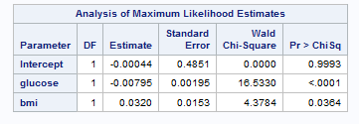
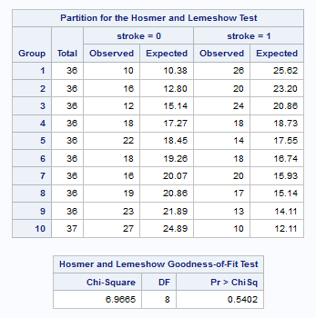
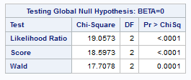
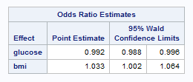
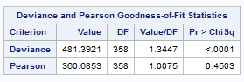
Model Fitting and Analysis (Multi-Variable Model #2)
Glucose level is highly significant
Glucose p-value is <0.0001
BMI is also statistically significant at a 95% confidence interval
BMI p-value is 0.0364
Likelihood ratio is 19.0573, indicating fit is better than for age alone.
Likelihood ratio p-value is <0.0001
The Pearson Test p-value is 0.4503
The Homer-Lemeshow Test p-value is 0.5402
Both tests indicate the model fits well
Model is Y= -0.00044+ 0.00795(glucose)-0.0320(BMI)+ε

Slide 12
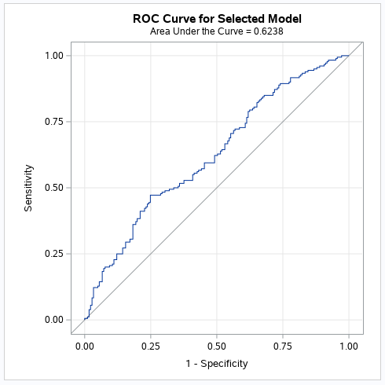
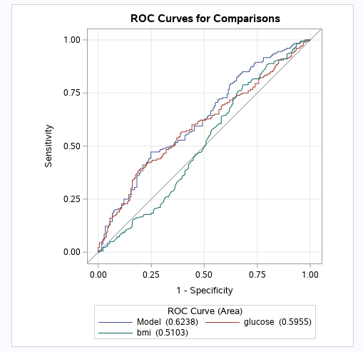
Model Fitting and Analysis Multivariable #2 ROC Curve
The ROC curve for BMI+Glucose has the area of 0.6238, which would indicate predictive value. The model ROC curve has better predictive power than either BMI or glucose alone
Code:
proc logistic data=StrokeData plots=ROC; model stroke (event='1') = glucose bmi/selection=backward; roc 'glucose' glucose; roc 'bmi' bmi; roccontrast reference('glucose')/estimate e; run;

Slide 13
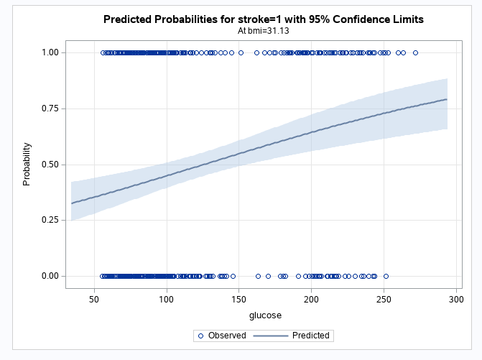
Model Fitting and Analysis (Multi-Variable Model #2 Probability)
Using predicted probabilities graphs, we can see the change in probability for a stroke with either BMI or glucose held constant.
Glucose behaves as expected when BMI is held constant, with probability >50% for stroke at glucose>125
Code for BMI held constant:
proc logistic data=StrokeData plots(only)=effect; model stroke(event='1') = glucose bmi/influence; run;

Slide 14
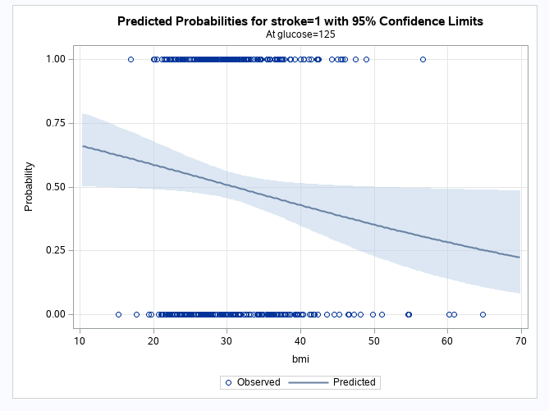
Model Fitting and Analysis (Multi-Variable Model #2 Probability)
Using predicted probabilities graphs, we can see the change in probability for a stroke with either BMI or glucose held constant.
BMI has an unexpected interaction with glucose, with the probability of stroke <50% at BMI>31.1
Code for Glucose held constant:
proc logistic data=StrokeData plots(only)=effect; model stroke(event='1') = bmi glucose/influence; run;

Slide 15
Conclusions
Measurable health factors identified that are predictive of stroke
Best to analyze risk associated with age separately from other factors
Important to investigate collinearity with age of variable additions
Further analysis on predictive factors
Assessment of predictive health factors to benefit diagnostic practices in:
Expand identification of at-risk population for target education/preventative diagnostic techniques at regular doctor’s visits
intervention techniques and slowing/halting cardiovascular disease
informing at-risk population of symptoms that require medical attention

Slide 16
Bibliography
https://www.ahajournals.org/doi/full/10.1161/01.str.28.10.1871
kaggle.com/fedesoriano/stroke-prediction-dataset
Thank you for watching!

Slide 17
Percentage of Effort
Name Percent of Total Effort
Elise Dixon 35%
Kyle Moran 35%
William Elijah-Clark 30%

